Slide 1
Intelligent Cubic Player: Tic-Tac-Toe 3D

Slide 2
Introduction
Intelligent Cubic Player for Tic-Tac-Toe 3D
The intelligent cubic player is a sophisticated AI program designed to play the game of Tic-Tac-Toe in a three-dimensional space. It utilizes advanced algorithms such as the Minimax Algorithm, Alpha-Beta Pruning, and Heuristic functions to make intelligent and strategic moves.
The purpose of the intelligent cubic player is to provide a challenging and engaging opponent for players of Tic-Tac-Toe 3D. It is capable of analyzing the game board, predicting future moves, and making optimal decisions based on the current state of the game.
With its advanced algorithms and heuristic functions, the intelligent cubic player can adapt to different playing styles and strategies. It is designed to provide a fair and competitive gaming experience, ensuring that players are constantly challenged and engaged.

Slide 3
HOW TO PLAY
Intelligent Cubic Player for Tic-Tac-Toe 3D
Here are the specific rules:
A player wins if they have four marks in a row on any horizontal layer.
A player wins if they have four marks in a row on any vertical layer.
A player wins if they have four marks in a row on any diagonal within a single layer.

Slide 4
HOW TO WIN
Intelligent Cubic Player for Tic-Tac-Toe 3D
Here are the specific rules:
Rows:
A player wins if they have four marks in a row on any horizontal row that spans across all layers.
A player wins if they have four marks in a row on any vertical row that spans across all layers.
A player wins if they have four marks in a row on any diagonal row that spans across all layers.
Columns:
A player wins if they have four marks in a row on any column that spans across all layers.
A player wins if they have four marks in a row on any diagonal column that spans across all layers.
Diagonals:
A player wins if they have four marks in a row along any diagonal that connects different layers.
The winning conditions are more complex due to the three-dimensional nature of the board.
Players need to strategize across layers, rows, and columns to achieve victory.
The game ends when one player successfully forms a line of four marks in any of the specified directions.
If the entire board is filled without a winner, the game is a draw.

Slide 5

Main Functionality of the Intelligent Cubic Player
The intelligent cubic player is a program that utilizes the Minimax Algorithm, Alpha-Beta Pruning, and Heuristic functions to play the game of 3D Tic-Tac-Toe.
The main functionality of the intelligent cubic player is as follows:
Evaluating the current state of the game board and determining the best move to make.
Using the Minimax Algorithm to recursively search through the game tree and find the optimal move.
Applying Alpha-Beta Pruning to optimize the search process and reduce the number of nodes evaluated.
Utilizing Heuristic functions to estimate the value of a game state and guide the search towards more promising moves.

Slide 6
Similar Ideas
Artificial Intelligence in Gaming
The intelligent cubic player in the Tic-Tac-Toe 3D game is an example of how artificial intelligence techniques can be applied to gaming.
Other games, such as chess and Go, have also seen advancements in AI-based players that can compete against human players.
Minimax Algorithm and Alpha-Beta Pruning
The intelligent cubic player utilizes the Minimax algorithm and Alpha-Beta pruning to make optimal decisions in the game.
These techniques are commonly used in game theory and AI to determine the best possible move in a game with multiple possible outcomes.
Heuristic Functions
The intelligent cubic player uses heuristic functions to evaluate the current state of the game and assign a value to each possible move.
These functions help in estimating the desirability of a move and guide the player towards making the best possible decision.

Slide 7
Game Overview
Rules
Tic-Tac-Toe 3D is a game played on a 3x3x3 grid, with two players taking turns to place their markers in an attempt to create a line of three markers in any direction: horizontally, vertically, diagonally, or even across different layers of the grid.
Objectives
The objective of the game is to be the first player to create a line of three markers in any direction. The line can be horizontal, vertical, diagonal, or even across different layers of the grid. The game ends when one player achieves this objective or when the entire grid is filled with markers and no player has won.

Slide 8
Advanced AI in Gaming
Challenges and Limitations
One of the main challenges of using advanced AI techniques in gaming is the need for large amounts of data to train the algorithms. This can be difficult to obtain, especially for smaller game developers or those with limited budgets.
Another limitation is the potential for bias in the data used to train the algorithms. This can lead to unfair or discriminatory outcomes in the game, which can be problematic for players and developers alike.
Finally, there is the challenge of balancing the use of AI with the need for player engagement and immersion. While AI can provide a more realistic and challenging experience, it can also take away from the sense of accomplishment and satisfaction that comes from overcoming challenges on one's own.
Solutions
To address the challenge of data availability, game developers can explore alternative sources of data, such as user-generated content or publicly available datasets. They can also consider partnering with other game developers or research institutions to share data and resources.
To address the issue of bias in the data, game developers can take steps to ensure that their data is diverse and representative of a wide range of players. They can also use techniques such as debiasing to mitigate the impact of bias in the algorithms.
To balance the use of AI with player engagement and immersion, game developers can provide players with options to customize their experience, such as adjusting the difficulty level or choosing between different AI settings. They can also focus on creating engaging and immersive gameplay mechanics that are not dependent on AI.

Slide 9
Challenges and Limitations of Advanced AI Techniques in Gaming
Potential for Bias in Data Used to Train Algorithms
One of the biggest challenges in using advanced AI techniques in gaming is the potential for bias in the data used to train algorithms. This can lead to unfair or discriminatory outcomes, particularly in games that involve real-world scenarios or simulations.
For example, if a game uses data from a particular demographic group to train its algorithms, it may not accurately represent the experiences or perspectives of other groups. This can lead to a lack of diversity and inclusivity in the game, which can be off-putting for players and detract from the overall gaming experience.
To address this challenge, game developers must be mindful of the data they use to train their algorithms and ensure that it is representative of all players. This may involve collecting data from a wider range of sources or using techniques like data augmentation to create more diverse training sets.

Slide 10
Intelligent Cubic Player for Tic-Tac-Toe 3D
Main Functionality
The Intelligent Cubic Player for Tic-Tac-Toe 3D is a game engine designed to play the classic game of Tic-Tac-Toe in a 3D environment. The game board is represented as a cubic grid, and the player can move their piece in any direction, including diagonally. The game ends when one player wins or when the board is completely filled with pieces.
Advanced AI Techniques
The Intelligent Cubic Player uses advanced AI techniques, such as machine learning algorithms and neural networks, to improve its gameplay. These techniques allow the player to make strategic moves and anticipate their opponent's moves, giving them a competitive edge in the game.

Slide 11
DIAGRAMS
OVERVIEW ABOUT BEST WAY TO WIN THE GAME.
BLOCK DIAGRAM
USE CASE ( UML )
FLOW CHARTS

Slide 12
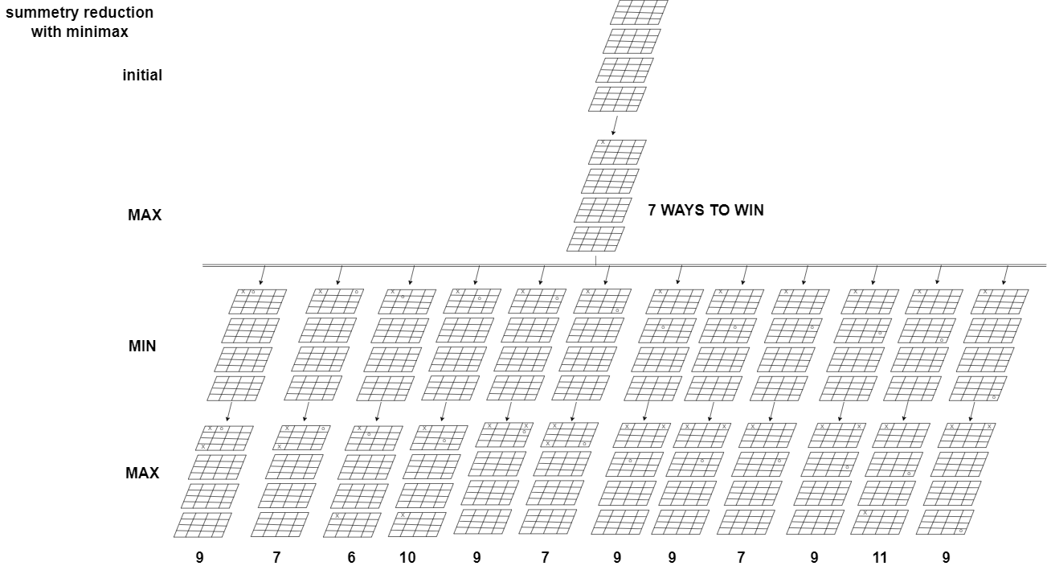
OVERVIEW ABOUT BEST WAY TO WIN THE GAME.

Slide 13
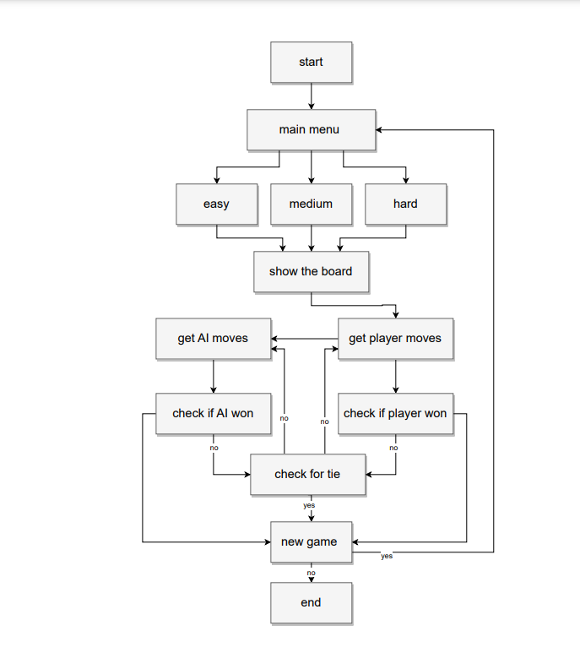
BLOCK DIAGRAM

Slide 14
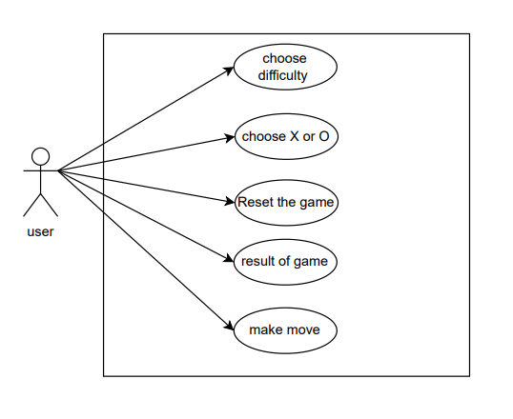
USE CASE ( UML )

Slide 15
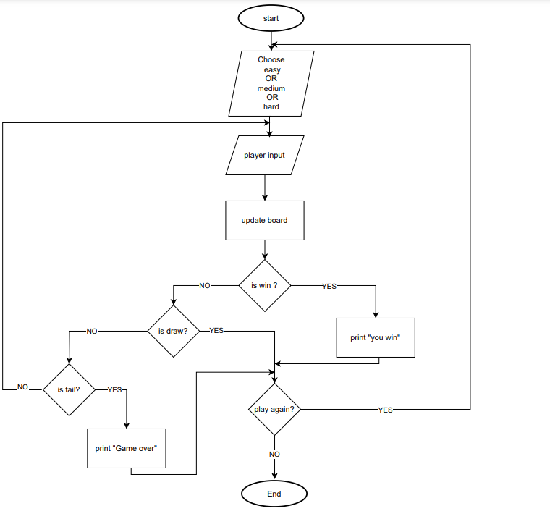
FLOW CHARTS ( for USER)

Slide 16
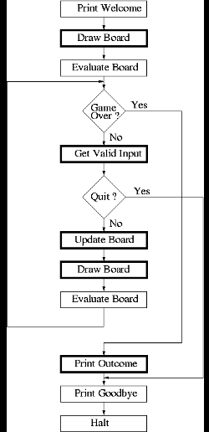
FLOW CHARTS ( for SYS)
Print the results
exit

Slide 17
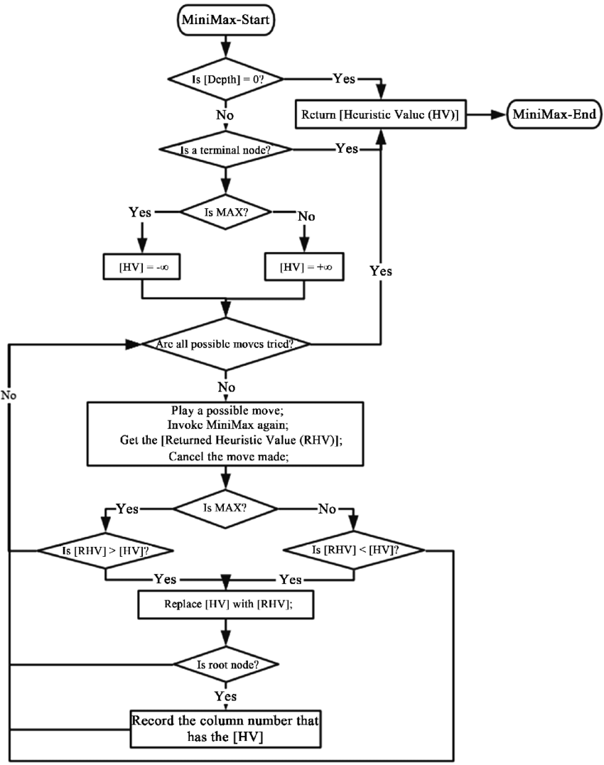
FLOW CHARTS ( MiniMax algorithm)

Slide 18
Minimax Algorithm
The Minimax Algorithm is a decision-making algorithm used in the intelligent cubic player for the Tic-Tac-Toe 3D game.
The algorithm evaluates all possible moves in the game and assigns a score to each move based on the current state of the game.
The goal of the algorithm is to maximize the score for the AI player and minimize the score for the opponent player.
The algorithm uses a recursive approach, exploring the game tree by considering all possible moves and their outcomes.
At each level of the game tree, the algorithm alternates between maximizing and minimizing the score.
The algorithm assumes that the opponent player will make the best possible move, and the AI player will make the best move based on that assumption.
The algorithm continues to explore the game tree until it reaches a terminal state, such as a win, loss, or draw.
Once the algorithm reaches a terminal state, it assigns a score to that state based on the outcome of the game.
The algorithm then backtracks and propagates the scores up the game tree, making decisions based on the highest or lowest scores.
By using the Minimax Algorithm, the intelligent cubic player can make optimal decisions in the Tic-Tac-Toe 3D game.

Slide 19

Alpha-Beta Pruning
The Alpha-Beta Pruning technique is an optimization algorithm used in the intelligent cubic player for the Tic-Tac-Toe 3D game.
Enhancing Performance
The Alpha-Beta Pruning technique improves the performance of the intelligent cubic player by reducing the number of nodes that need to be evaluated in the game tree.
Efficient Search
By using Alpha-Beta Pruning, the intelligent cubic player can efficiently search through the game tree, avoiding unnecessary evaluations of nodes that are guaranteed to be worse than previously evaluated nodes.
Cutting Off Unpromising Branches
The Alpha-Beta Pruning technique allows the intelligent cubic player to cut off branches of the game tree that are determined to be unpromising, further reducing the number of nodes that need to be evaluated.

Slide 20
Heuristic Functions
Evaluation Function
The evaluation function is a heuristic function used to evaluate the current state of the game and assign a score to it. It takes into account various factors such as the number of winning lines, the number of occupied cells, and the potential for future wins. The higher the score, the more favorable the position is for the intelligent cubic player.
Winning Lines Heuristic
The winning lines heuristic is used to prioritize moves that contribute to potential winning lines. It assigns a higher score to moves that create or extend winning lines and a lower score to moves that do not. This heuristic helps the intelligent cubic player focus on strategic moves that increase its chances of winning.
Occupied Cells Heuristic
The occupied cells heuristic is used to discourage moves that result in a high number of occupied cells. It assigns a lower score to moves that lead to a crowded game board and a higher score to moves that maintain a balanced distribution of occupied cells. This heuristic helps the intelligent cubic player avoid situations where the game is likely to end in a tie.
Future Wins Heuristic
The future wins heuristic is used to prioritize moves that have the potential to lead to future wins. It assigns a higher score to moves that create opportunities for multiple winning lines in future moves. This heuristic helps the intelligent cubic player anticipate and plan ahead for future winning moves.

Slide 21
Implementation
The intelligent cubic player for the Tic-Tac-Toe 3D game was implemented using the Minimax Algorithm, Alpha-Beta Pruning, and Heuristic functions. These techniques allow the player to make intelligent decisions and optimize its gameplay strategy.
The implementation was done using the following programming languages and frameworks:
Python: The main implementation of the intelligent cubic player was done in Python, which is a versatile and widely-used programming language.
NumPy: NumPy, a Python library for numerical computations, was used for efficient array operations and matrix calculations in the implementation.
TKinter: TKinter, a Python library for game development, was used for creating the graphical user interface (GUI) of the Tic-Tac-Toe 3D game.

Slide 22

Demo
Intelligent Cubic Player
Experience the power of the intelligent cubic player in action during a live demonstration of the Tic-Tac-Toe 3D game.

Slide 23
Conclusion
In conclusion, the intelligent cubic player for the Tic-Tac-Toe 3D game is a powerful tool that utilizes the Minimax Algorithm, Alpha-Beta Pruning, and Heuristic functions to enhance gameplay and provide an optimal strategy for players.
By analyzing all possible moves and their outcomes, the intelligent cubic player can make informed decisions and choose the best move to maximize the chances of winning.
The benefits of using the intelligent cubic player include:
Improved gameplay experience with challenging and strategic moves.
Enhanced decision-making skills for players by providing insights into optimal moves.
Increased chances of winning by choosing the most advantageous moves.

